Slide 1
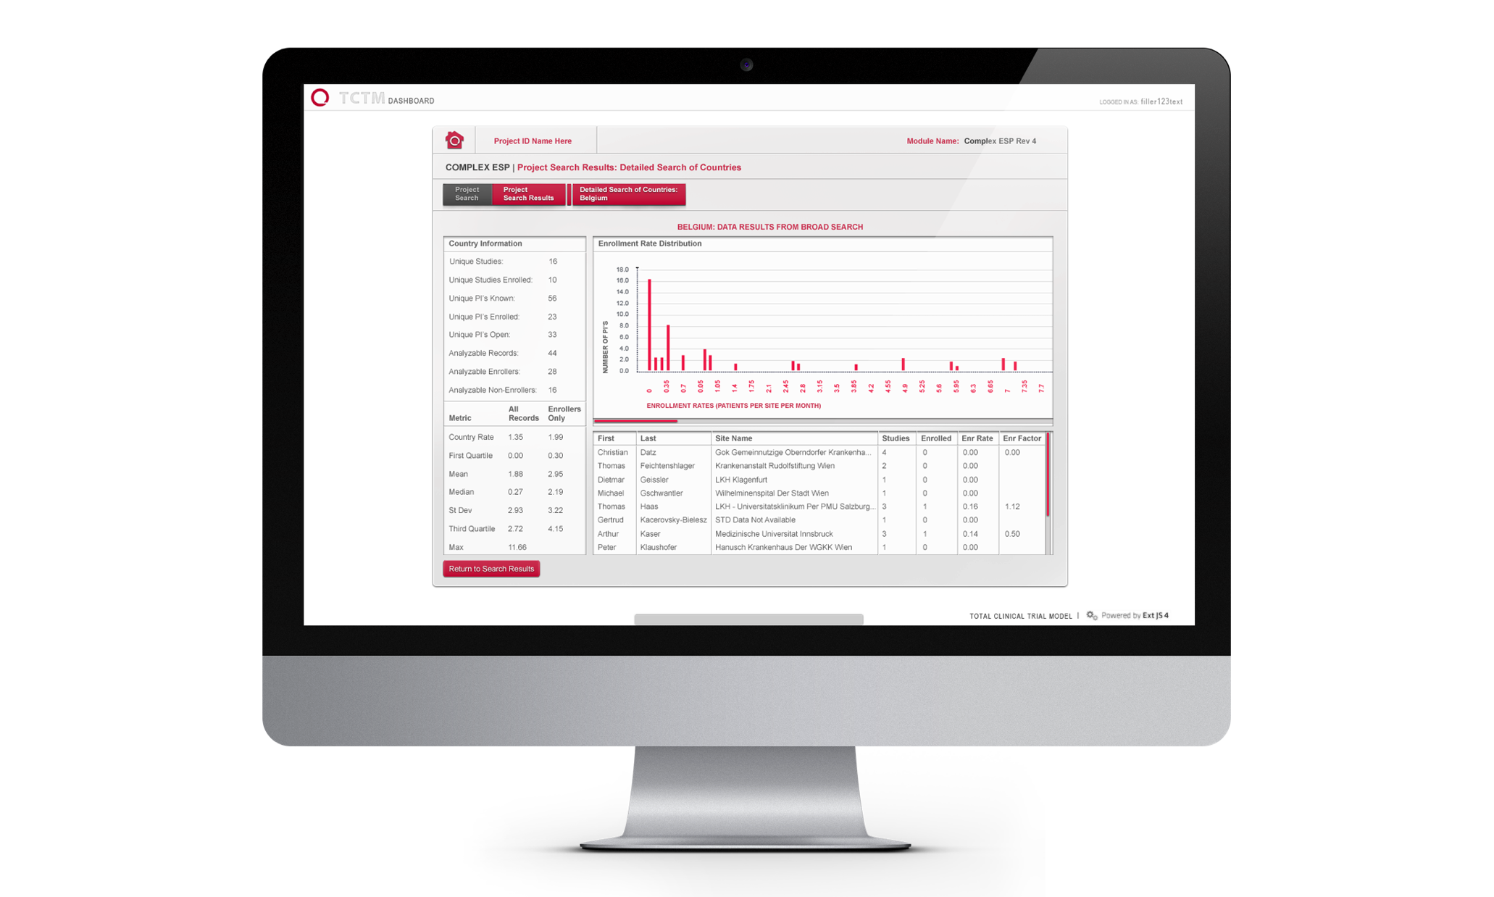
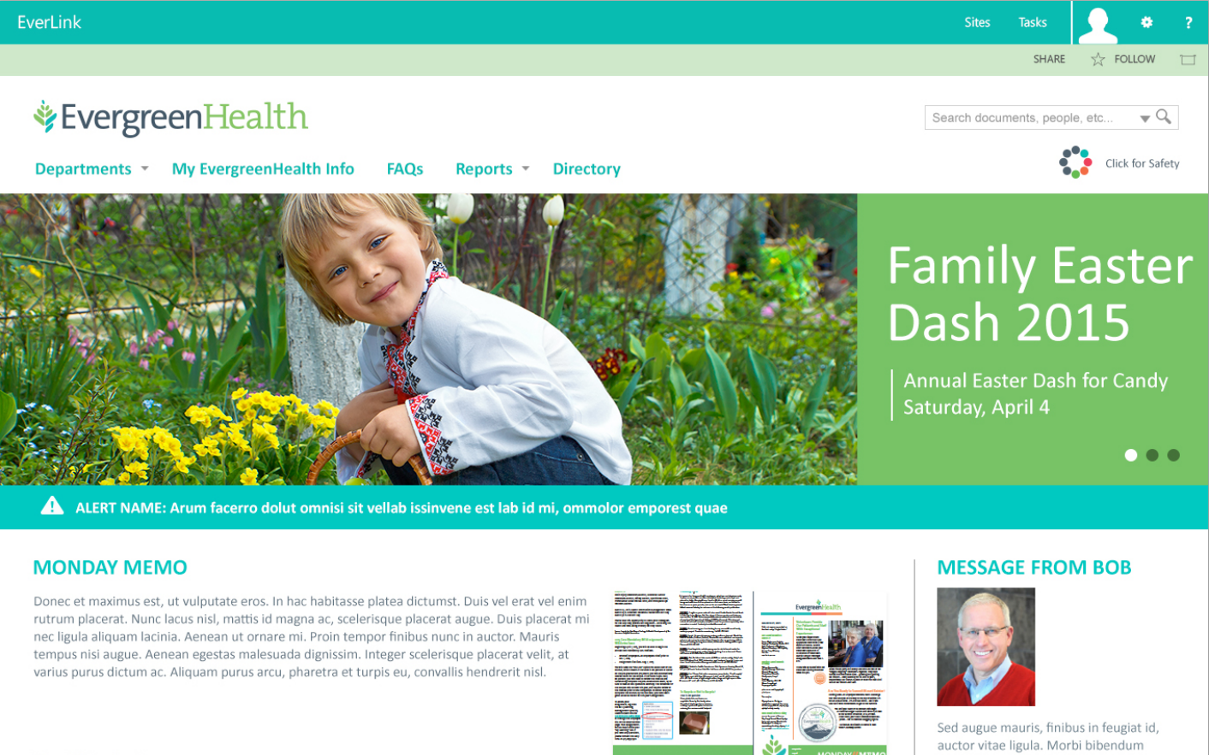
Evergreen Health – Employee Portal
What We Did
Affirma worked with Evergreen Health to design and implement their employee portal on SharePoint. The Evergreen team leverages the portal to automate internal processes, distribute recent news, announcements, and content.
Social integration helps facilitate feedback and discussion around news/procedural items between Providers and Central Administration.
Calendar functionality and event management is incorporated to streamline scheduling and staffing.

Slide 2
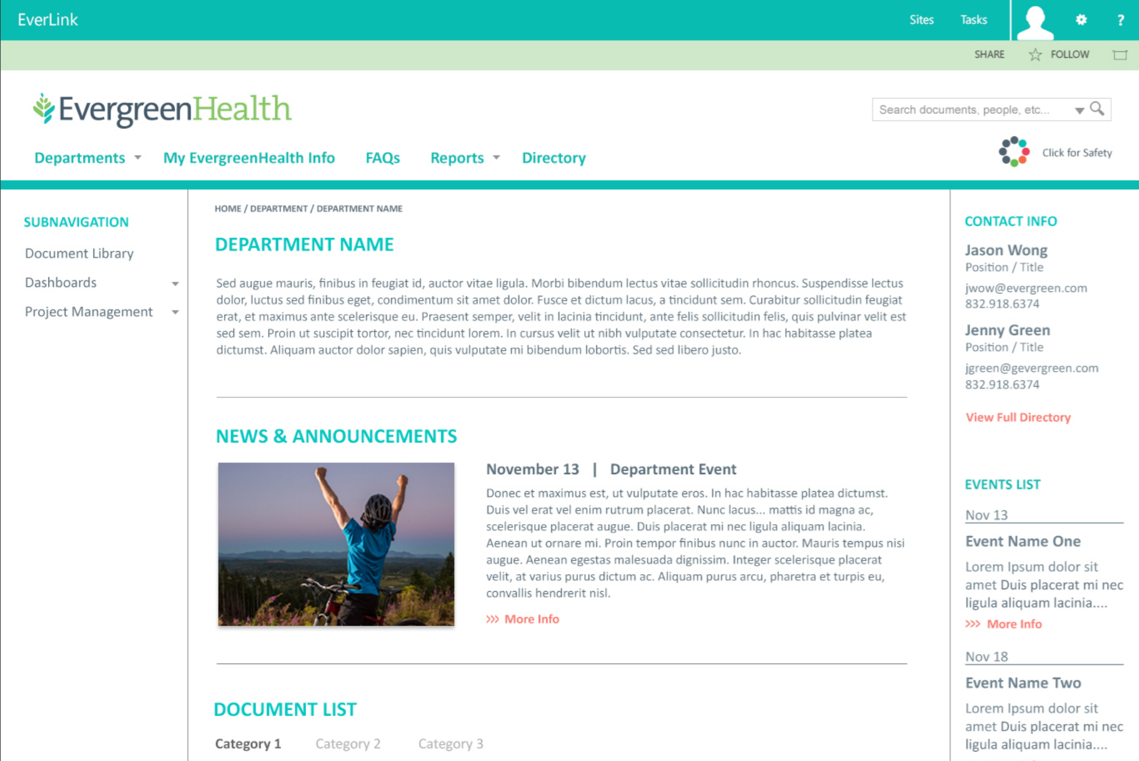
Evergreen Health – Employee Portal

